Slide 1
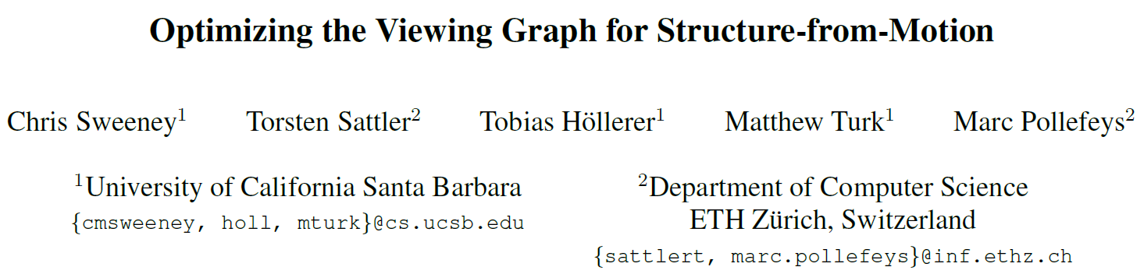
International Conference on Computer Vision (ICCV),2011.
Reporter: Ge Linlin
Date: 2019.05.27

Slide 2
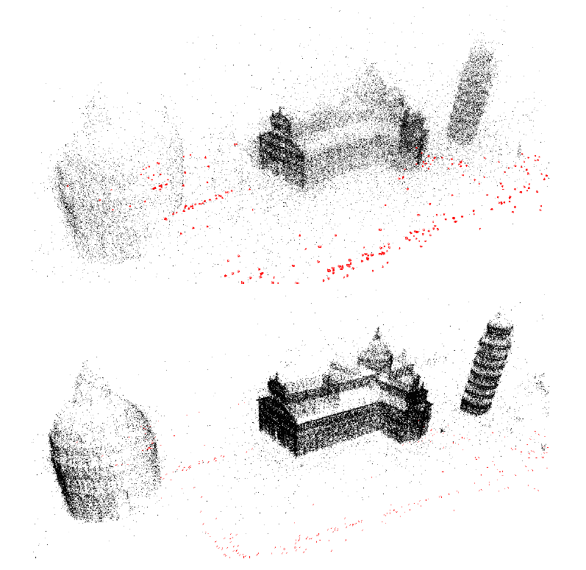
1. Introduction
A novel optimization that improves the quality of the relative geometries by enforcing loop consistency constraints with the epipolar point transfer.

Slide 3
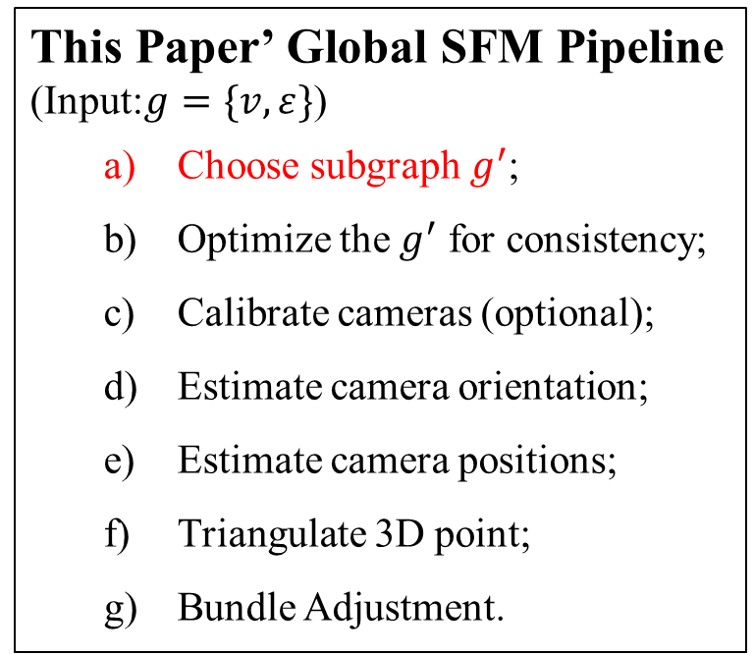
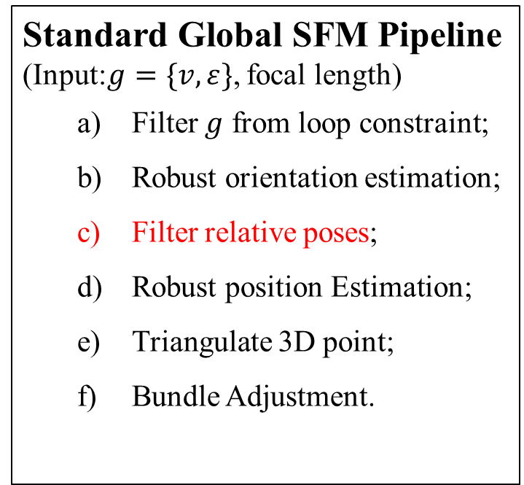
1. Introduction
Standard Global SFM Pipeline
(Input:$g=\{v,ε\}$, focal length)
Filter $g$ from loop constraint;
Robust orientation estimation;
Filter relative poses;
Robust position Estimation;
Triangulate 3D point;
Bundle Adjustment.
This Paper’ Global SFM Pipeline
(Input:$g=\{v,ε\}$)
Choose subgraph $g^{′}$;
Optimize the $g^{′}$ for consistency;
Calibrate cameras (optional);
Estimate camera orientation;
Estimate camera positions;
Triangulate 3D point;
Bundle Adjustment.

Slide 4
1. Introduction
Contributions:
It is the first global SFM pipeline capable of handling uncalibrated image sets;
It provide a new method for calibrating cameras at scale from a set of fundamental matrices;
A scalable calibration method for determining focal lengths of uncalibrated cameras is presented;
The pipeline proposed in this paper achieves greater efficiency and comparable accuracy to the other methods.

Slide 5
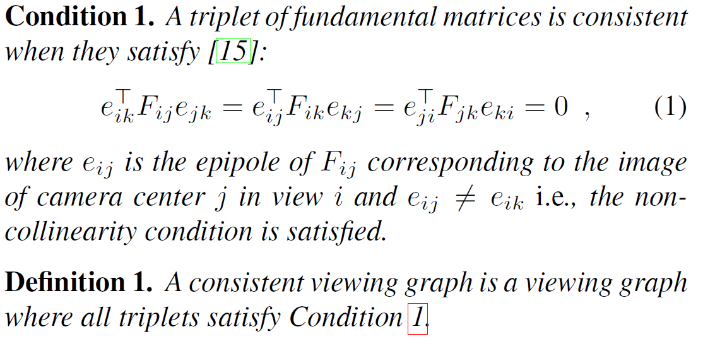
2. Definition

Slide 6
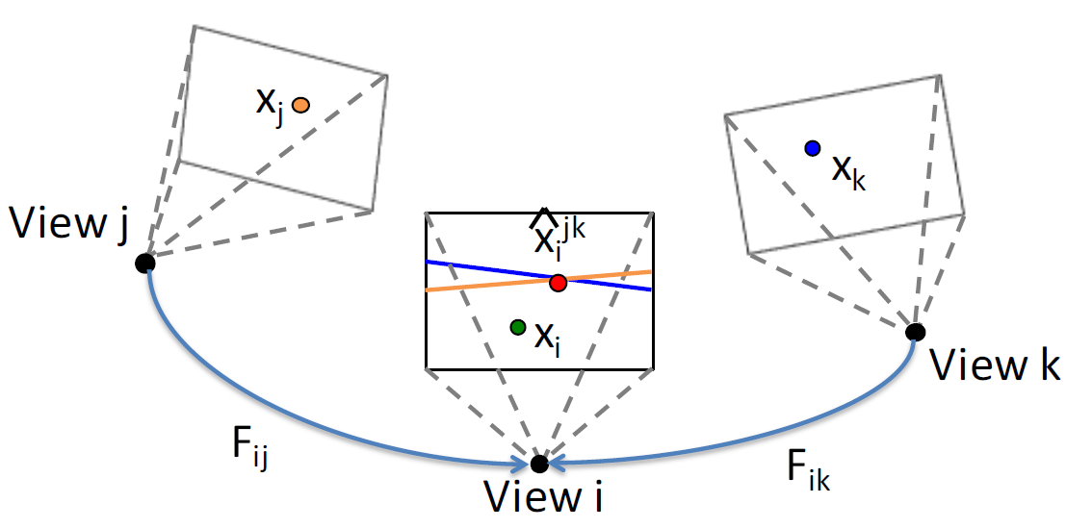
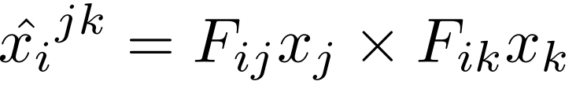
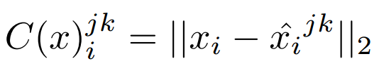
3. Create a Consistent Viewing Graph
Loop Consistency
Epipolar point Transfer:
Cost Function:

Slide 7

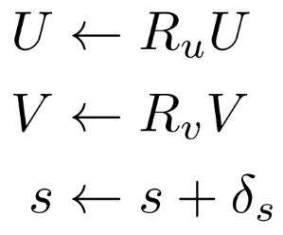
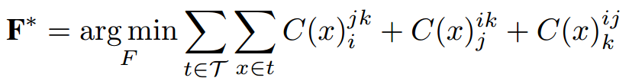

3. Create a Consistent Viewing Graph
Adjust Fundamental Matrices
SVD for fundamental matrix:
Define adjustment parameters:
Nonlinear Optimization
Define new objective function by considering loop consistency constraint:
$x$ is a feature track
Effect:
Greatly improved the rate of convergence.

Slide 8
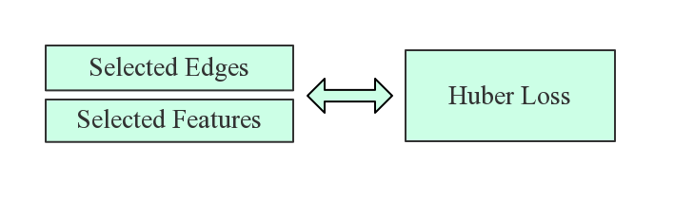
4.1 Viewing Graph Optimization
Target
Find a minimal set of edges that provide sufficient coverage over all views in the viewing graph.
Optimization Structure

Slide 9
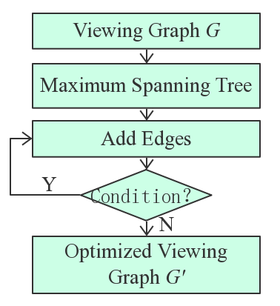
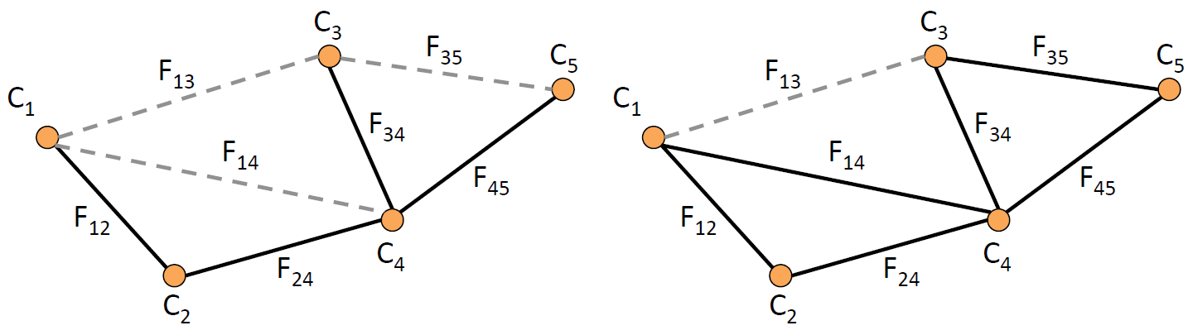
4.1 Viewing Graph Optimization
Edge Optimization
Condition
Every view is in at least one triplet.
There are no more “good” edges that can be added.

Slide 10
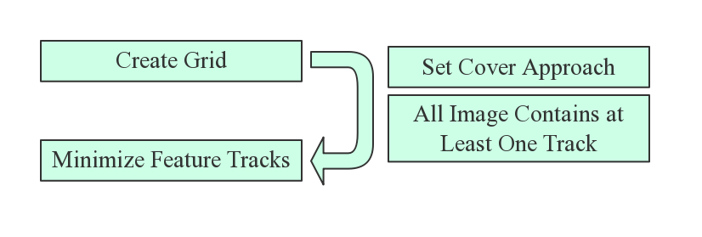
4.1 Viewing Graph Optimization
Features Optimization

Slide 11
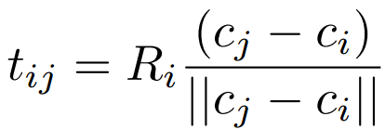
4.2 Estimating Motion
Assume cameras have been calibrated
Solve orientation
Cost function: relative rotation constraint
Use the angle-axis parameterization to solve for matrices
Initialization: chaining relative rotation from a random spanning tree
enforcing the relative rotation constraint

Slide 12
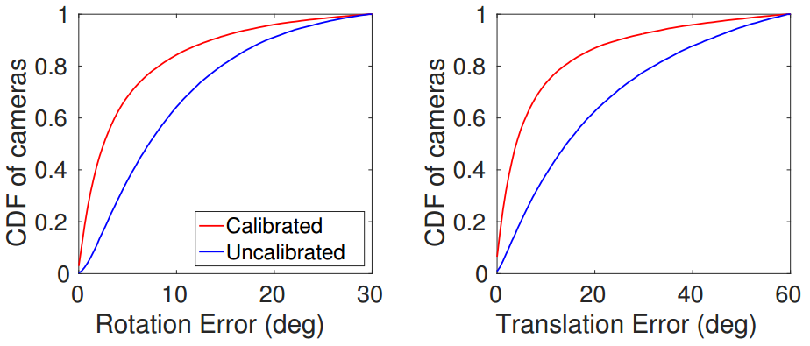
4.3 Calibrated Vs. Uncalibrated

Slide 13


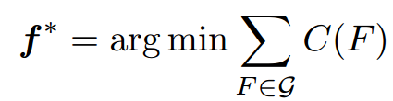
5 Focal Length Calibration
Cost Function Definition:
Objective Function:
Where f ∗ = { f₀, . . . , f_{n} } is the set of all focal lengths of all views in the viewing graph G.

Slide 14
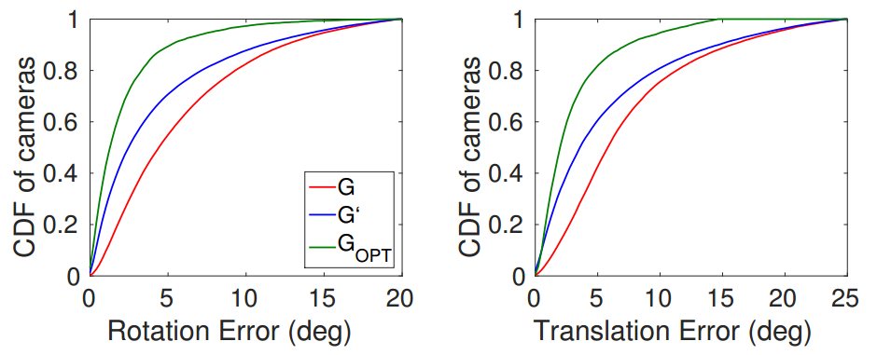
6 Test for Viewing Graph Optimization

Slide 15
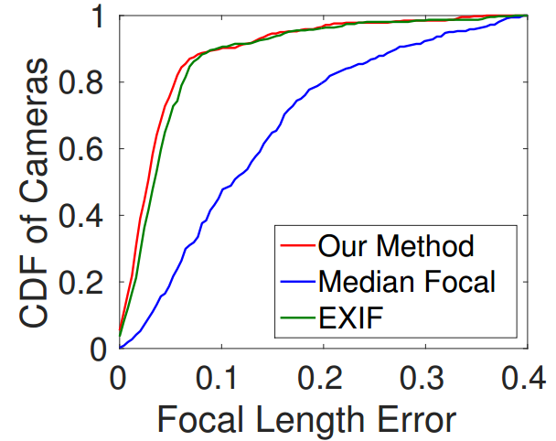
6 Results——Test for Focal Length Calibration

Slide 16
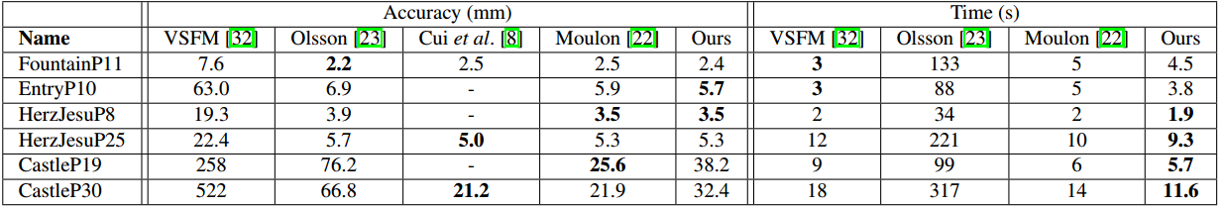
6 Results—— Test for Proposed Pipeline
Accuracy results on small-scale datasets:

Slide 17
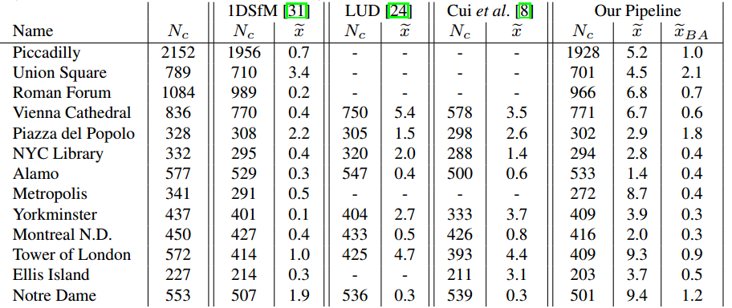
6 Results——Test for Proposed Pipeline
Median position results on large-scale datasets:

Slide 18
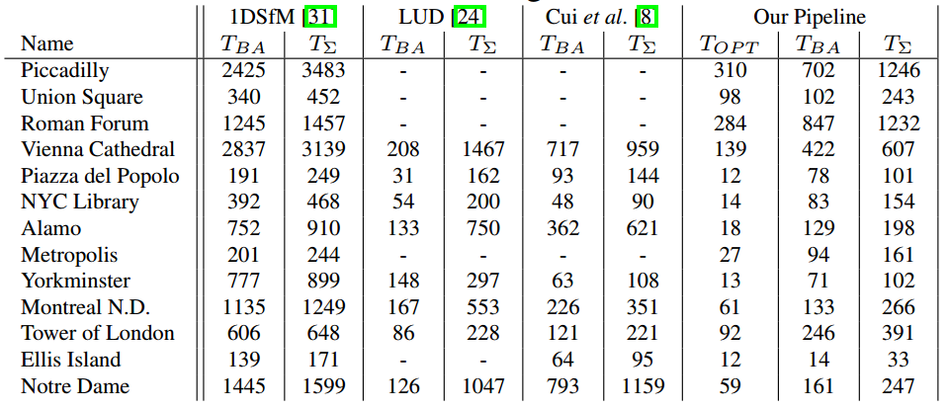
6 Results——Test for Proposed Pipeline
Test result on large-scale datasets:

Slide 19
5. Conclusion
we propose an optimization that corrects the viewing graph and enforces global consistency via loop constraints before applying SfM;
we provide a new method for calibrating cameras from a set of fundamental matrices;
We incorporated the viewing graph optimization and focal length calibration into a global SfM pipeline.

Slide 20
Q1: What is SO(3) rotation and O(3) matrices?
Q2: Why the epipole is in the null space of fundamental matrix？
Q3: What is the norm of transfer line?
Q4: How to get fundamental matrix?

Slide 21
Thanks!

